Slide 1
DFD for Expense Tracker

Slide 2
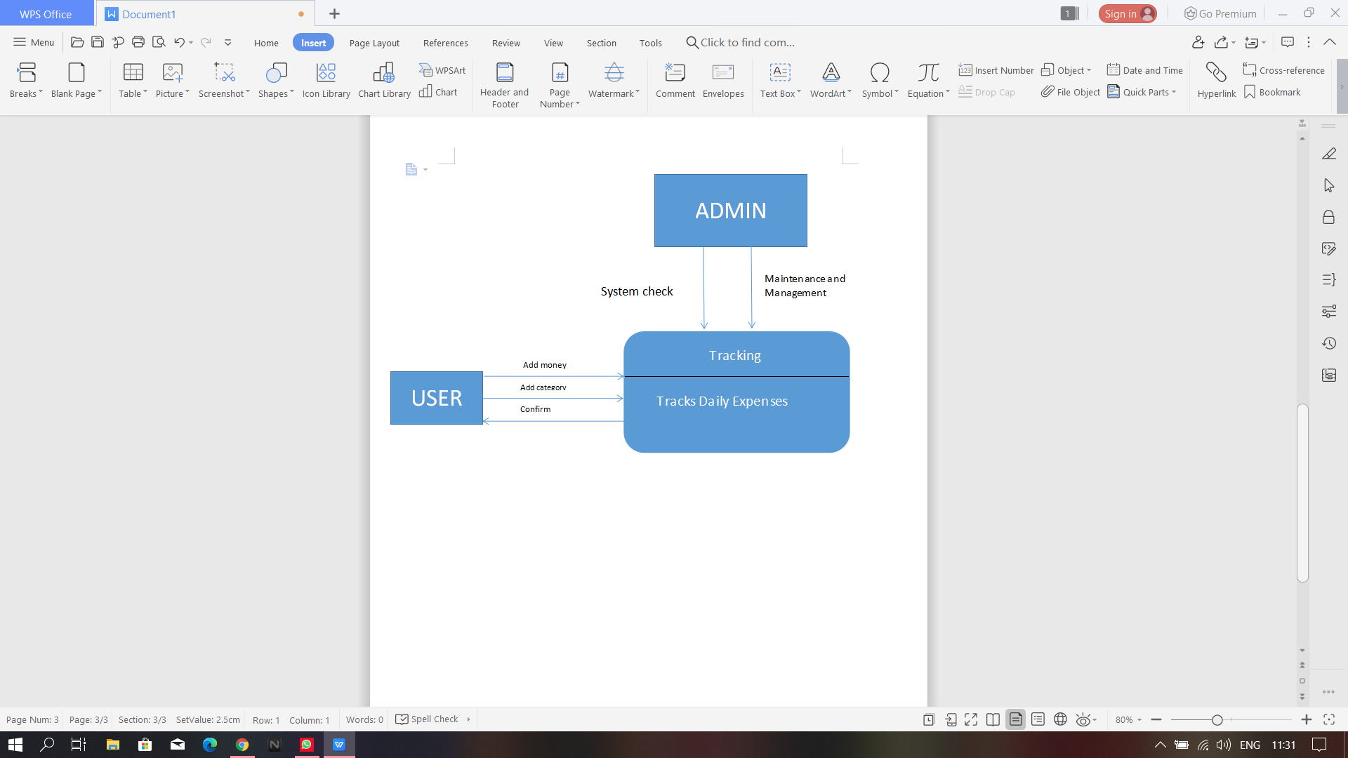
DFD level-0
The diagram below shows the dfd level-0 where the user adds money to the expense tracker. The tracking system will update the database and the database will rettrive it to the tracking system. after retriving the user confirms the data and the admin checks the system and its maintenance.

Slide 3
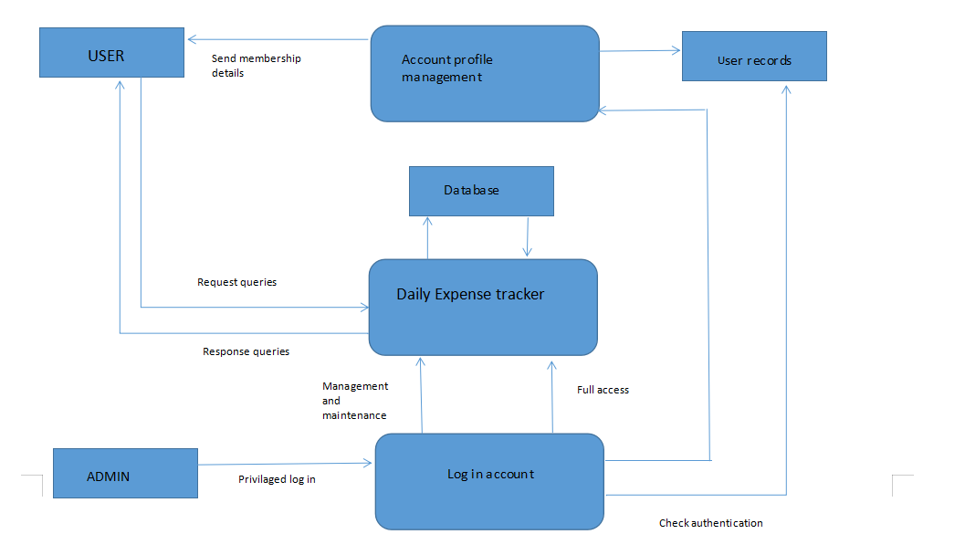
DFD level-1

Slide 4
DFD level-1
The above diagram is the dfd level 1 diagram where the user can track the data through its process it is involving. The process is further divides as account profile management and log in management. The user requests queriess from the daily expense tracker and recieves response from it. The log in system checks the authentication of the user and the account profile management sends the membership details to the user.

